Slide 1

Introduction to Neural Networks
Part 1
github.com/gmarchet/dnnworkshop5

Slide 2
Pretensions to Thinking
“The Analytical Engine has no pretensions whatever to originate anything. It can do whatever we know how to order it to perform… Its province is to assist us in making available what we are already acquainted with.”

Slide 3
Still just pretending?
Google Duplex
What next?

Slide 4
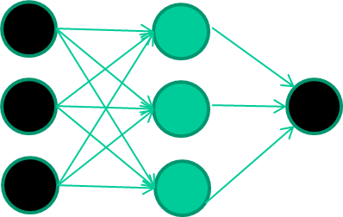
Network Example: Binary Classification
Feature 1 | Feature 2 | Feature 3 | Class
1.1 | 2.2 | 3.3 | 0
4.5 | 6.7 | 2.8 | 1
0.8 | 4.2 | 3.5 | 0
4.2 | 2.8 | 6.1 | 1

Slide 5
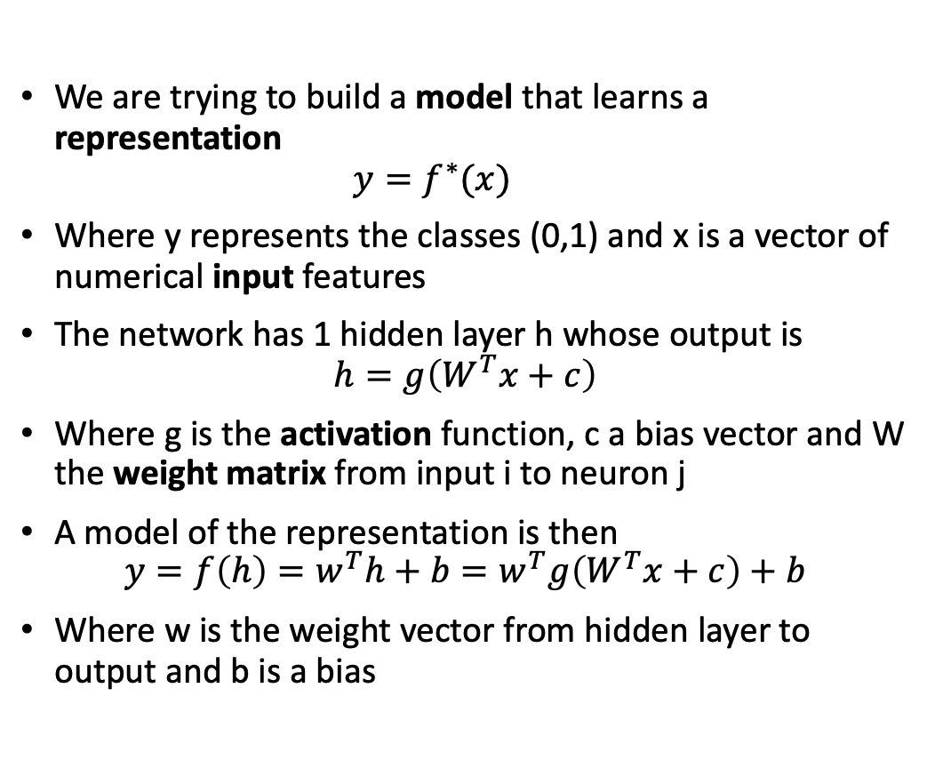
Representation
We are trying to build a model that learns a representation
$$y=f^{∗}(x)$$
Where y represents the classes (0,1) and x is a vector of numerical input features
The network has 1 hidden layer h whose output is
$$h=g\left(W^{T}x+c\right)$$
Where g is the activation function, c a bias vector and W the weight matrix from input i to neuron j
A model of the representation is then
$$y=f\left(h\right)=w^{T}h+b=w^{T}g\left(W^{T}x+c\right)+b$$
Where w is the weight vector from hidden layer to output and b is a bias
Notes:
As with most learning algorithms, we need a data set, a model, a loss or cost function and an optimization algorithm

Slide 6
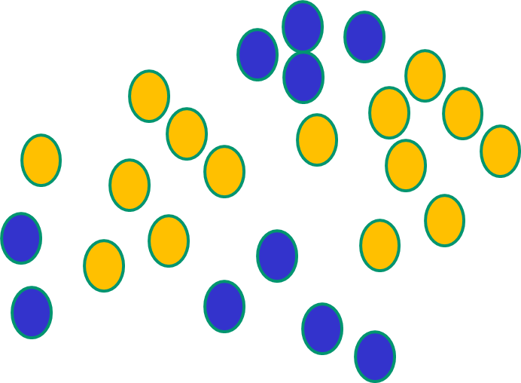
Non-Linearity
If f(x) is linear, the NN can only draw straight decision boundaries (even if there are many layers of units)

Slide 7
Activation
Linear Units for gaussian output distributions
Used for regression problems
Sigmoid Units for Bernoulli output distributions
Used for binary classification, where we predict P(y=1|x)
Softmax Units for multi-Bernoulli output distributions
Used for multi-class classification, winner-take-all
Rectified Linear Units (ReLU) for hidden layers
Default choice, other possible but not often recommended

Slide 8
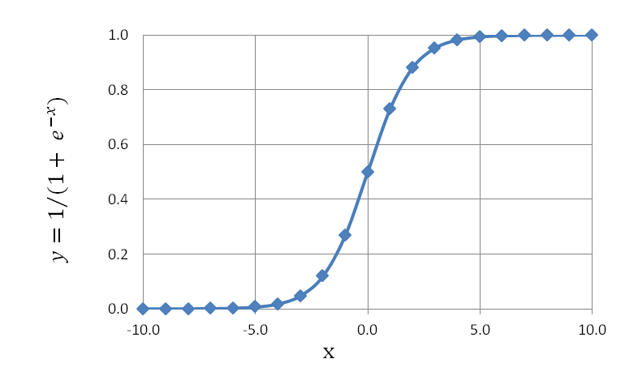
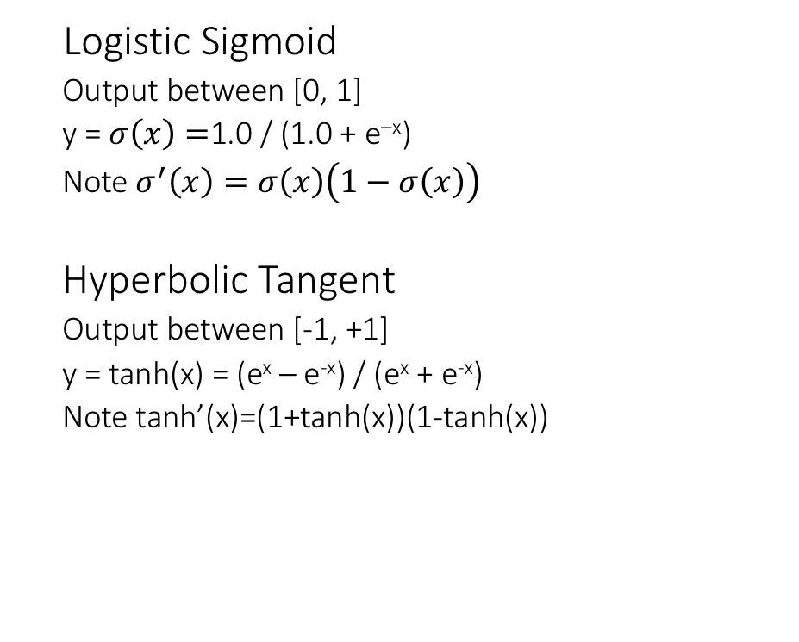
Common Activation Functions
Logistic Sigmoid
Output between [0, 1]
y = $σ\left(x\right)=$1.0 / (1.0 + e^{–x})
Note $σ^{′}\left(x\right)=σ\left(x\right)\left(1−σ\left(x\right)\right)$
Hyperbolic Tangent
Output between [-1, +1]
y = tanh(x) = (e^{x} – e^{-x}) / (e^{x} + e^{-x})
Note tanh’(x)=(1+tanh(x))(1-tanh(x))
Notes:
In reality for hidden nodes the choice is often more art than science. Logistic and tanh saturate, converge slowly and are more costly to differentiate and compute, hence ReLU

Slide 9
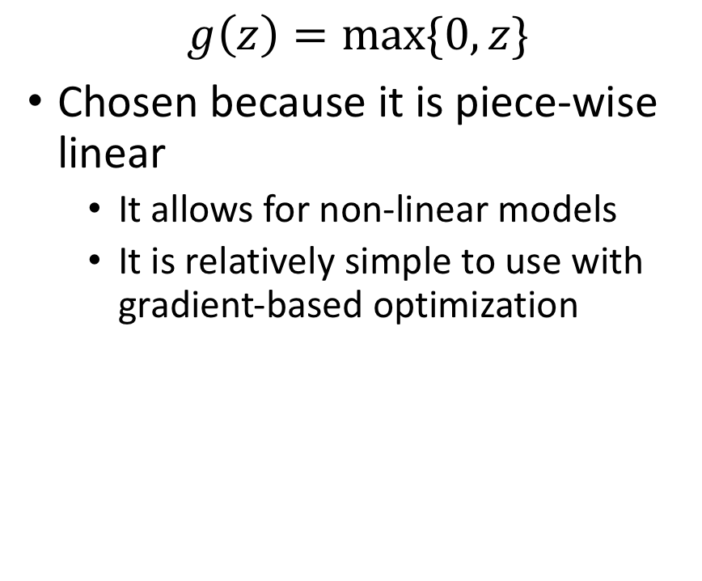
Rectified Linear Unit (ReLU)
$$g\left(z\right)=max⁡\{0,z\}$$
Chosen because it is piece-wise linear
It allows for non-linear models
It is relatively simple to use with gradient-based optimization

Slide 10
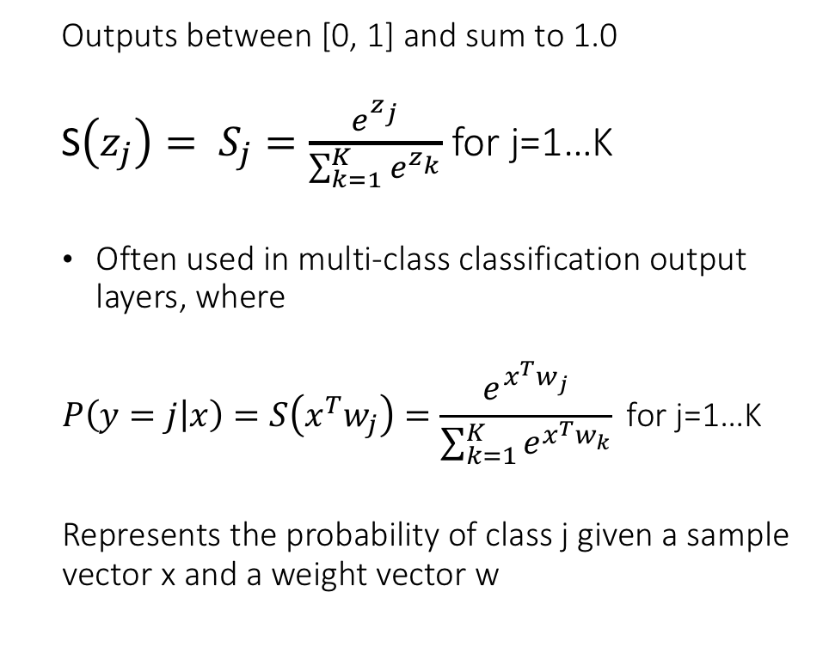
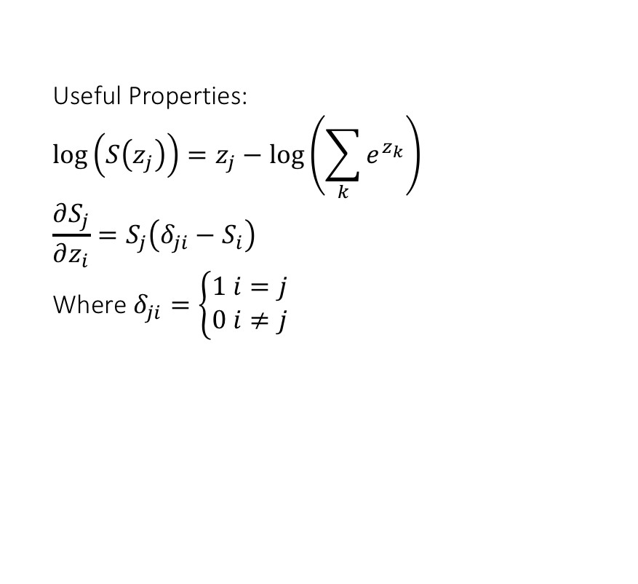
Softmax Activation Function
Outputs between [0, 1] and sum to 1.0
S$\left(z_{j}\right)= S_{j}=\frac{e^{z_{j}}}{\sum_{k=1}^{K}{e^{z_{k}}}}$ for j=1…K
Often used in multi-class classification output layers, where
$$P\left(y=j | x\right)=S\left(x^{T}w_{j}\right)=\frac{e^{x^{T}w_{j}}}{\sum_{k=1}^{K}{e^{x^{T}w_{k}}}} \text{for} \text{j}\text{=1…}\text{K}$$
Represents the probability of class j given a sample vector x and a weight vector w
Useful Properties:
$$\log\left(S\left(z_{j}\right)\right)=z_{j}−\log\left(\sum_{k}{e^{z_{k}}}\right)$$
$$\frac{∂S_{j}}{∂z_{i}}=S_{j}\left(δ_{ji}−S_{i}\right)$$
Where $δ_{ji}=\left\{\begin{matrix}1 i=j \\ 0 i≠j\end{matrix}\right.$

Slide 11
Learning
For a machine to learn a representation, it needs:
A data set
A model
A loss (or error or cost function)
An optimization method
It alters the parameters of the model to minimize its loss
It has been proven that NN thus constructed can in theory approximate any function, i.e. learn any representation

Slide 12
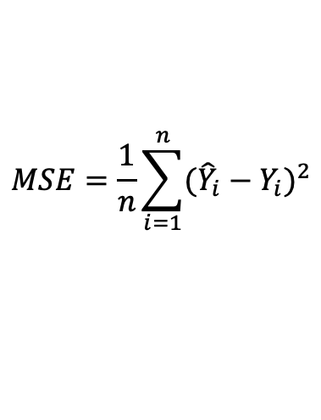
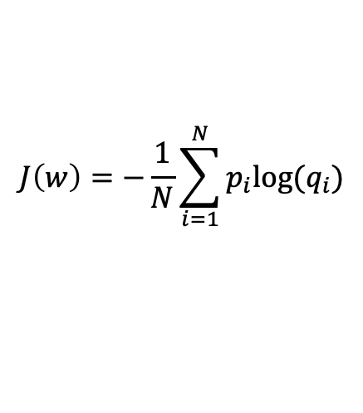
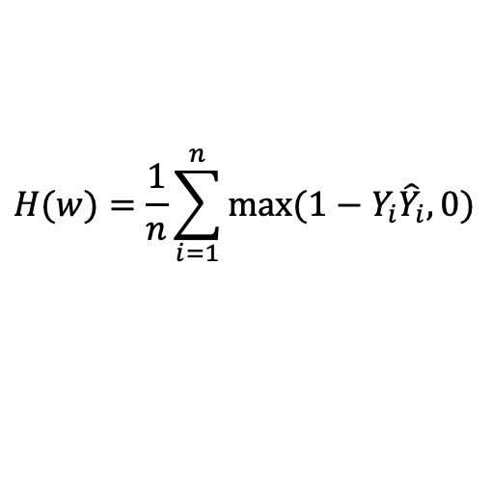
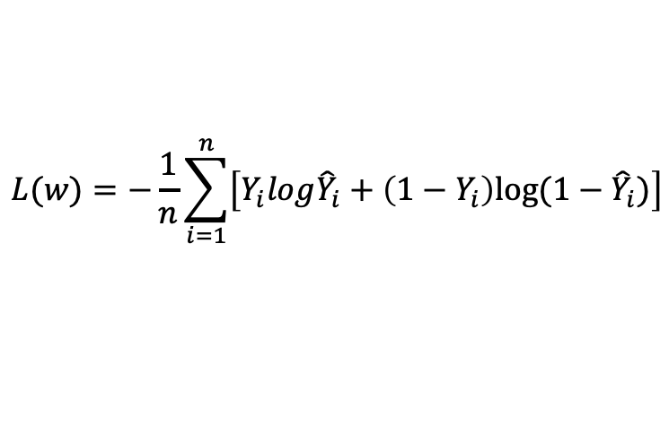
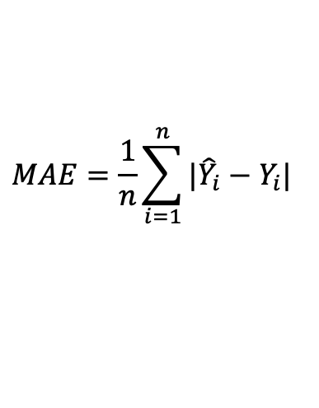
Common Loss Functions
For regression problems
$$MSE=\frac{1}{n}\sum_{i=1}^{n}{{({\hat{Y}}_{i}−Y_{i})}^{2}}$$
$$MAE=\frac{1}{n}\sum_{i=1}^{n}{{|{\hat{Y}}_{i}−Y_{i}|}^{}}$$
$$J\left(w\right)=−\frac{1}{N}\sum_{i=1}^{N}{p_{i}{log⁡(q}_{i}})$$
For classification problems
$$L(w)=−\frac{1}{n}\sum_{i=1}^{n}{\left[Y_{i}log{\hat{Y}}_{i}+\left(1−Y_{i}\right)log⁡(1−{\hat{Y}}_{i})\right]}$$
$$H(w)=\frac{1}{n}\sum_{i=1}^{n}{max⁡(1−Y_{i}{\hat{Y}}_{i}, 0)}$$
Notes:
In case of linear regression, mse is guaranteed to be convex – so a global minimum can be found
J is cross-entropy generic definition
L is a variation of cross-entropy aka log-loss for binary problems where we use the logistic sigmoid, i.e. g(wx)=1/(1+exp(-wx))
Yhat is a prediction
For H or hinge loss it matters to have variables normalized in -1,1

Slide 13
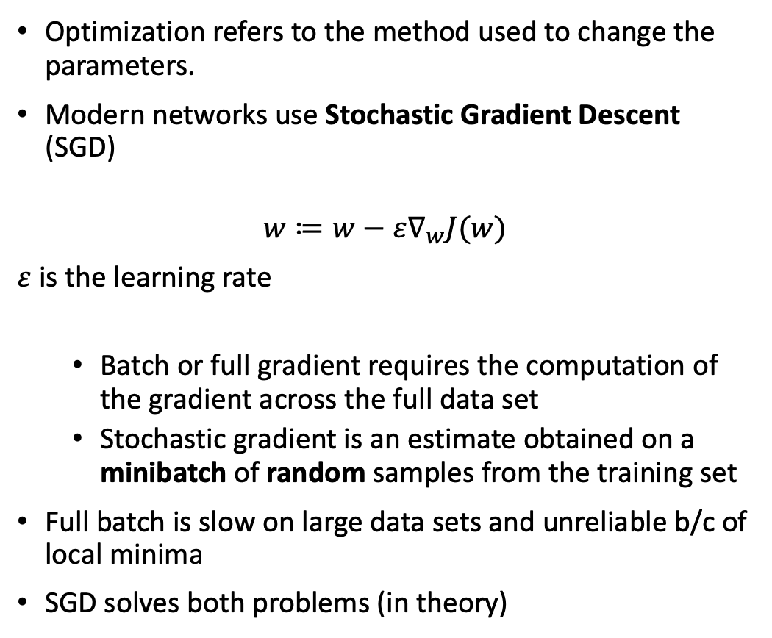
Optimization
Optimization refers to the method used to change the parameters.
Modern networks use Stochastic Gradient Descent (SGD)
$$w≔w−ε∇_{w}J(w)$$
$ε$is the learning rate
Batch or full gradient requires the computation of the gradient across the full data set
Stochastic gradient is an estimate obtained on a minibatch of random samples from the training set
Full batch is slow on large data sets and unreliable b/c of local minima
SGD solves both problems (in theory)
Notes:
Learning rate needs not be constant. It is generally small, but can be varied to optimize the algorithm

Slide 14
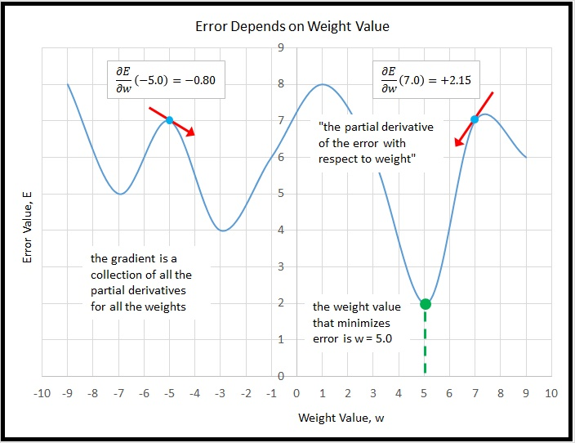

Slide 15
SGD for Humans
Input learning rate, initial set of weights and biases
While stopping criterion (e.g. error value, n. of iterations) not met
Sample a minibatch from training set and relative targets
Predict the output (forward pass)
Compute the error
Compute gradient estimate (backward pass)
Update the parameters
End while
Return the parameters

Slide 16
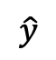
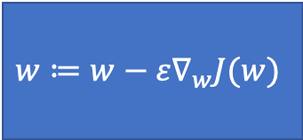
Learning Process
Target
y
y=f(Wx+b)
Compute Loss J(w)
$$\hat{y}$$
Input
x
$$w≔w−ε∇_{w}J(w)$$

Slide 17
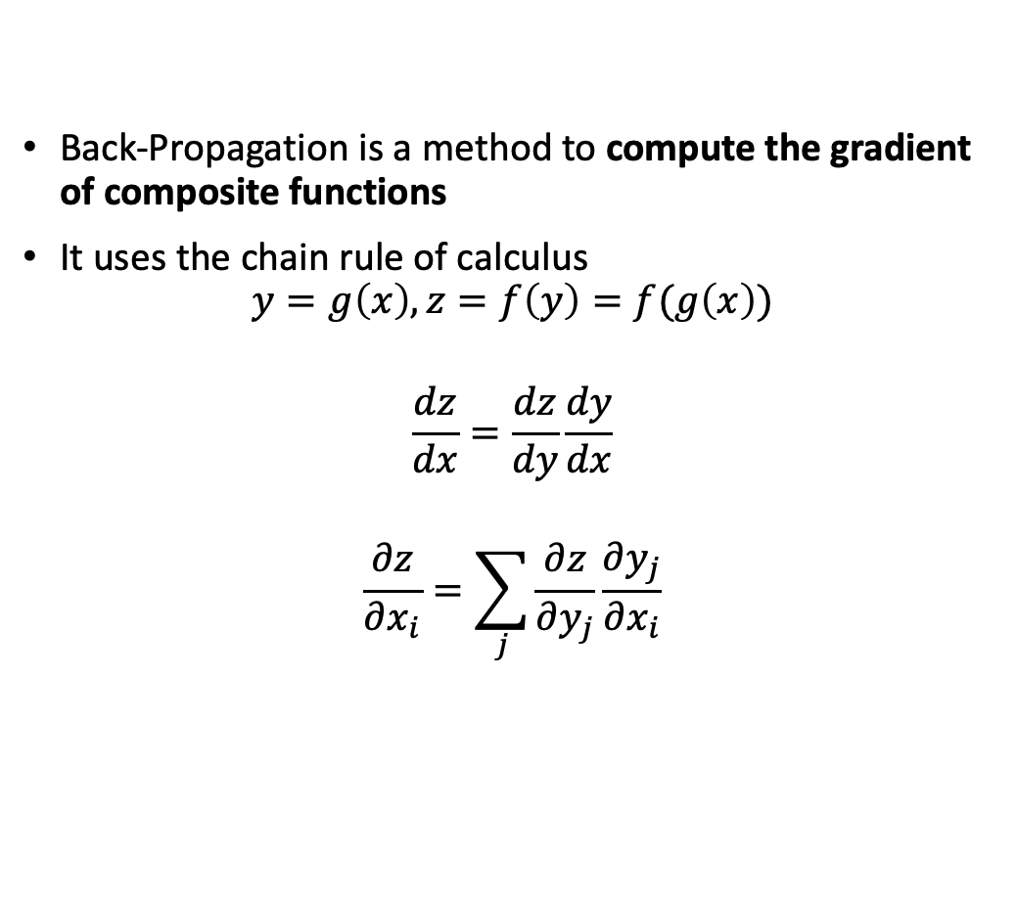
Back-Propagation
Back-Propagation is a method to compute the gradient of composite functions
It uses the chain rule of calculus
$$y=g\left(x\right), z=f\left(y\right)=f(g\left(x\right))$$
$$\frac{dz}{dx}=\frac{dz}{dy}\frac{dy}{dx}$$
$$\frac{∂z}{∂x_{i}}=\sum_{j}{\frac{∂z}{∂y_{j}}\frac{∂y_{j}}{∂x_{i}}}$$

Slide 18
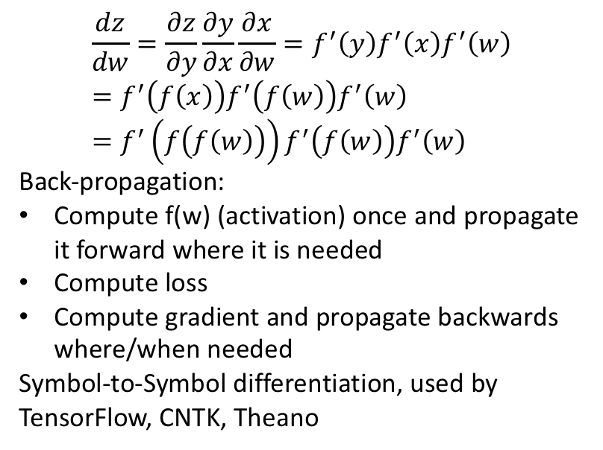
Propagation on a Graph
$$\frac{dz}{dw}=\frac{∂z}{∂y}\frac{∂y}{∂x}\frac{∂x}{∂w}=f^{′}\left(y\right)f^{′}\left(x\right)f^{′}\left(w\right)=f^{′}\left(f\left(x\right)\right)f^{′}\left(f\left(w\right)\right)f^{′}\left(w\right)=f^{′}\left(f\left(f\left(w\right)\right)\right)f^{′}\left(f\left(w\right)\right)f^{′}\left(w\right)$$
Back-propagation:
Compute f(w) (activation) once and propagate it forward where it is needed
Compute loss
Compute gradient and propagate backwards where/when needed
Symbol-to-Symbol differentiation, used by
TensorFlow, CNTK, Theano
From Goodfellow 2017

Slide 19





Computational Graph Frameworks

Slide 20
Q&A
Now you know…

